Slide 1
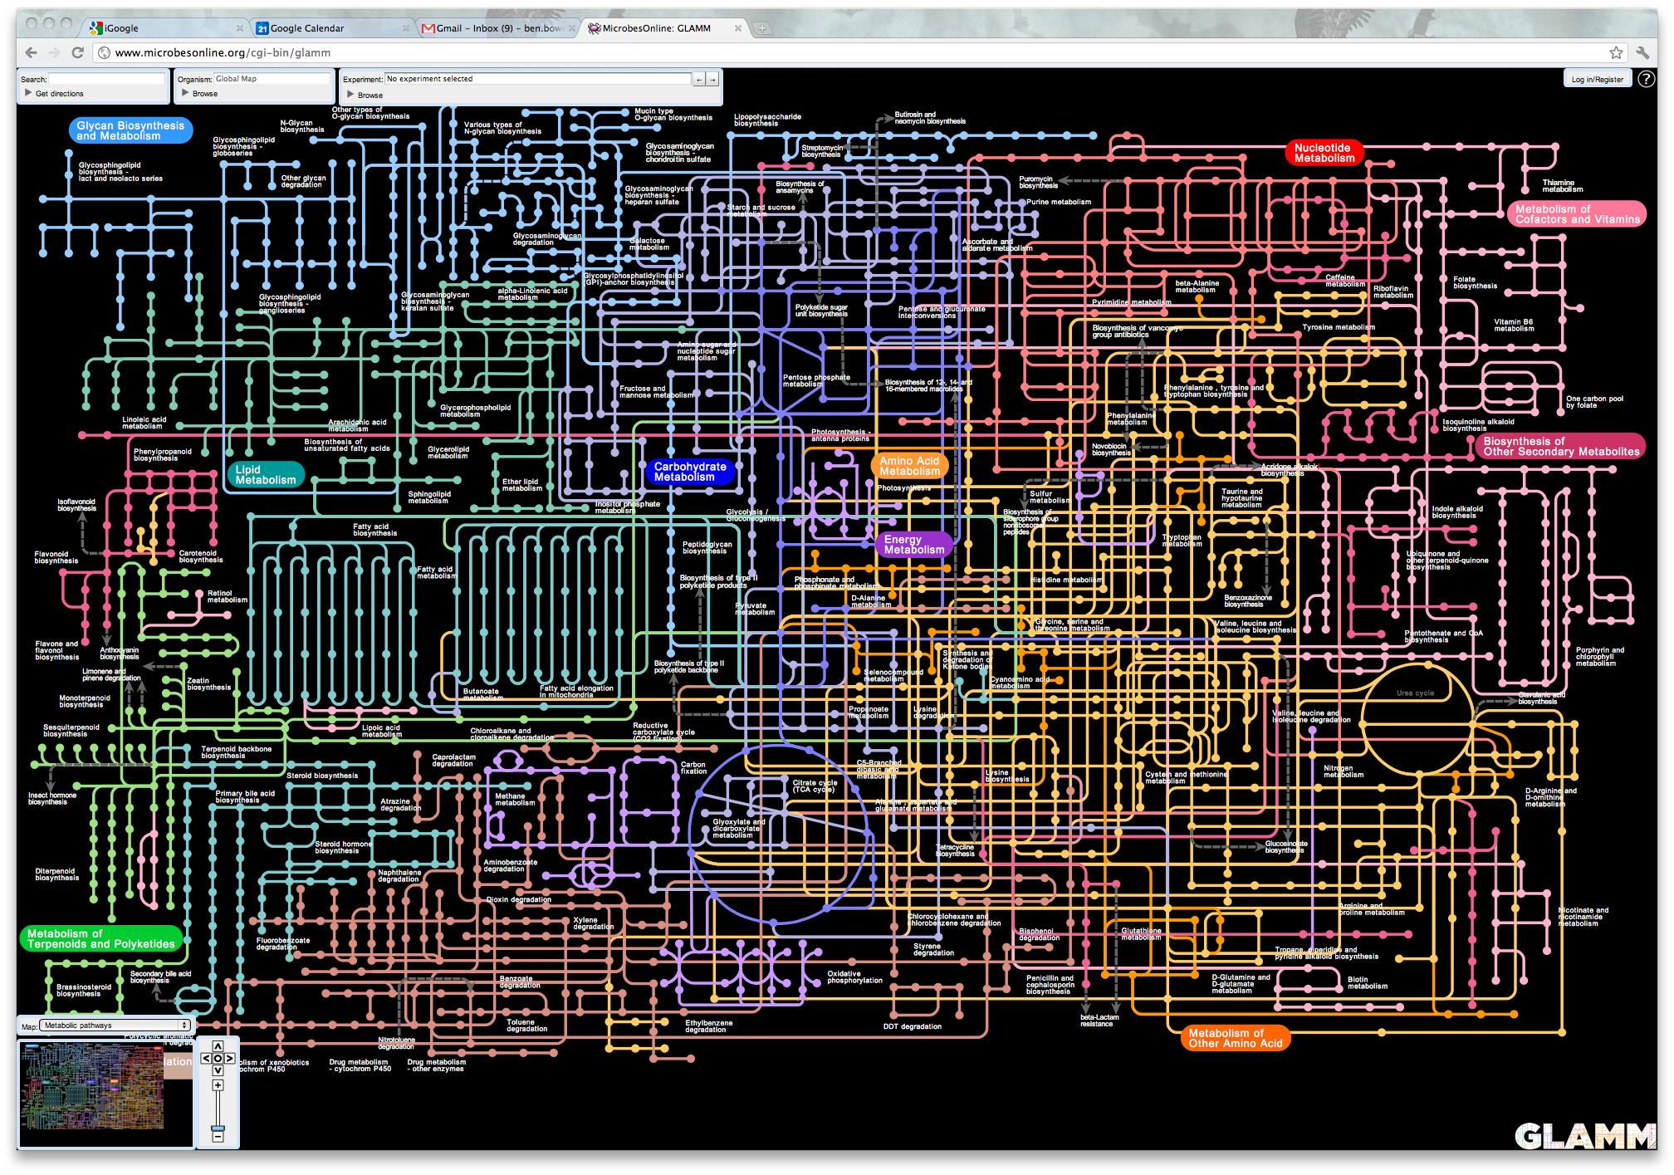
Entry point is a map of biochemistry, compounds, and reactions

Slide 2
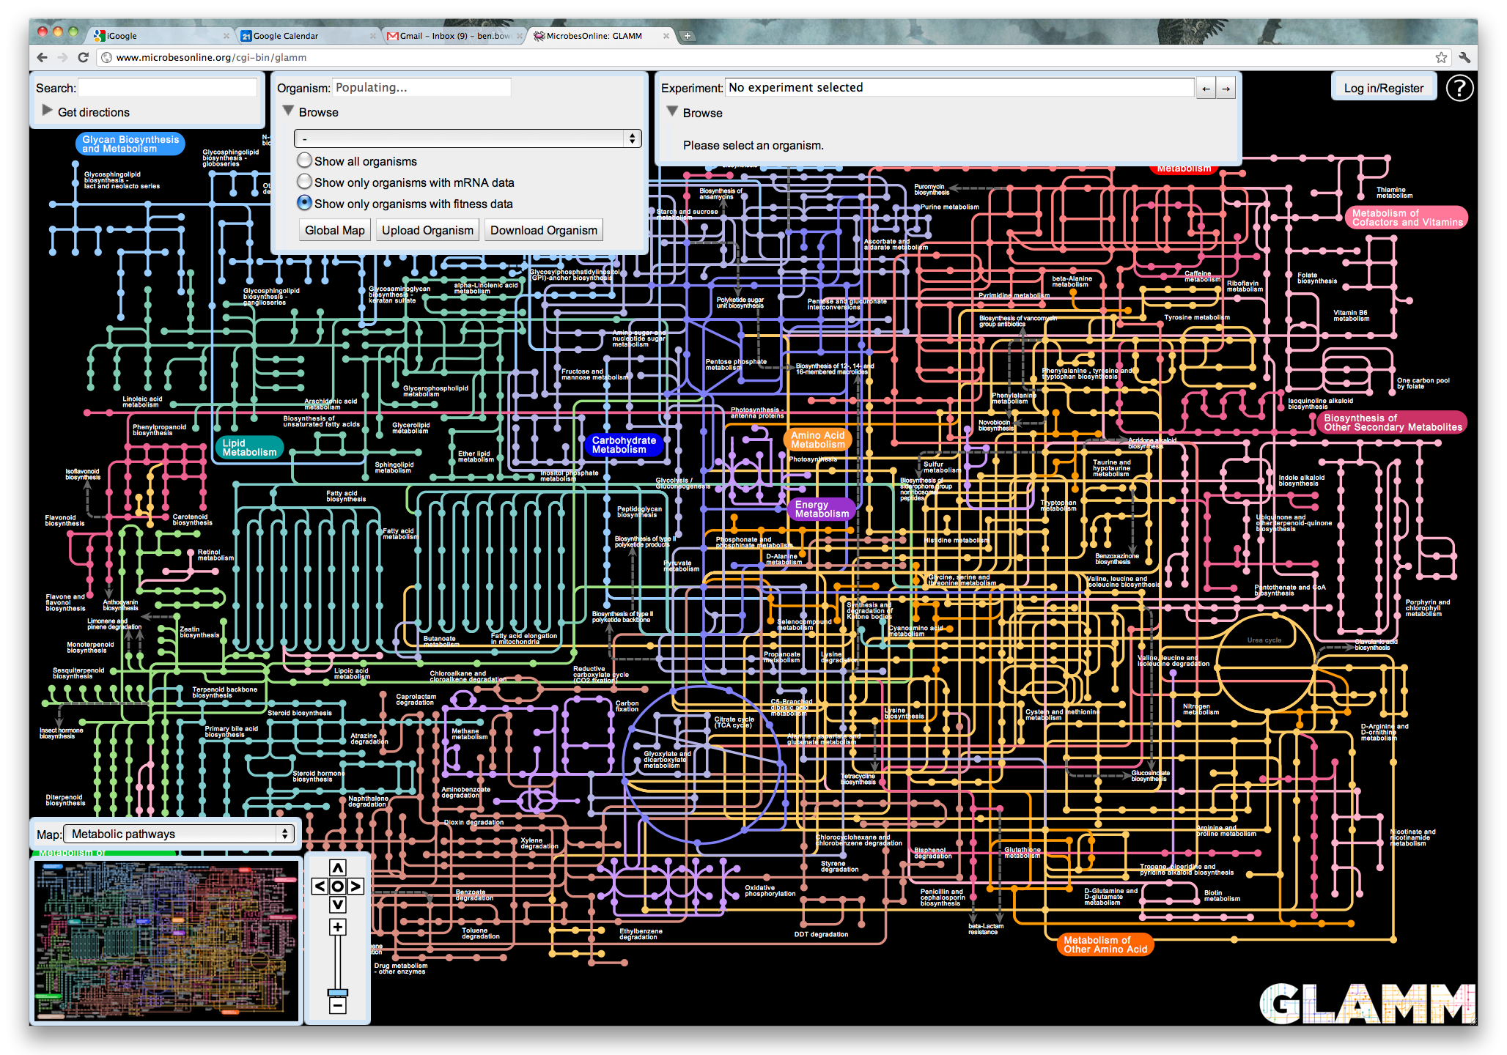
Small dialog boxes offer dynamic content based on user preferences and setting

Slide 3
The user can select various types of experiments to perform
Experiments could be based on classes:
Strain engineering: Test media formulations, and knockouts
Model QA/QC: Test growth predictions against experimental evidence
Strain comparisons: Compare function of model components to other models and conditions
Exploration: Better understand biochemistry and chemical structures
Regulation: Paste co-expression & co-regulation knowledge onto the map

Slide 4
For all of these cases, the components offer clickable options to obtain the source and mechanism for the evidence
Experiments could be based on classes:
Strain engineering: Test media formulations, and knockouts
Model QA/QC: Test growth predictions against experimental evidence
Strain comparisons: Compare function of model components to other models and conditions
Exploration: Better understand biochemistry and chemical structures
Regulation: Paste co-expression & co-regulation knowledge onto the map

Slide 5
Example: Right click on a metabolite or reaction
Options
Remove from objective function
Test media-formulations for synthesis
Test gene-essentiality for synthesis
View compound information
Highlight related compounds in model

Slide 6
Example: Selection of a series of compounds and reactions
Options
Show matching organisms
Test media-formulations for synthesis
Test gene-essentiality for synthesis
View compound information
Highlight related compounds in model
Example: Selection of a series of compounds and reactions

Slide 7
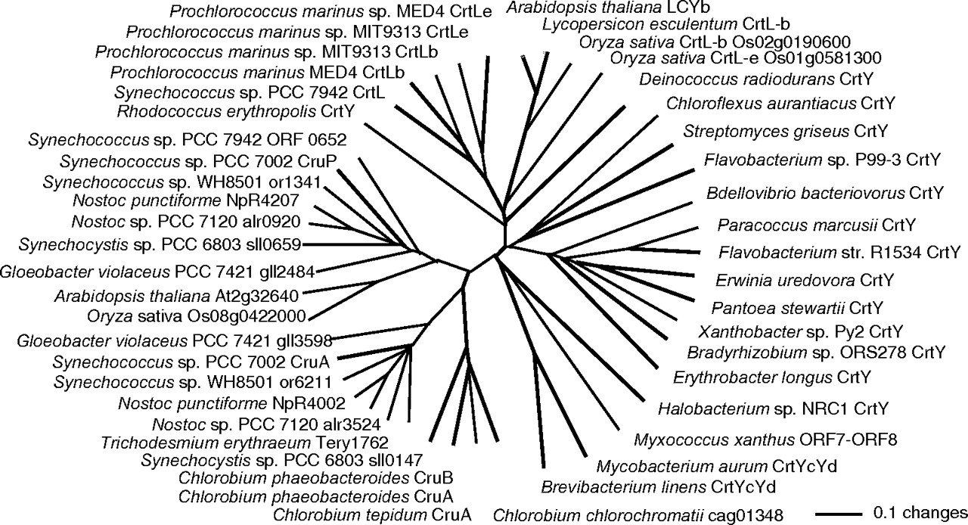
Phylogenetic tree of organisms containing selected pathway fragment

Slide 8
Select an organism that is unexpected
Phylogenetic tree of organisms containing selected pathway fragment
Options
Show matching organisms
View metabolic reconstruction
Compare metabolism
View genome
Explore experimental datasets

