Slide 1
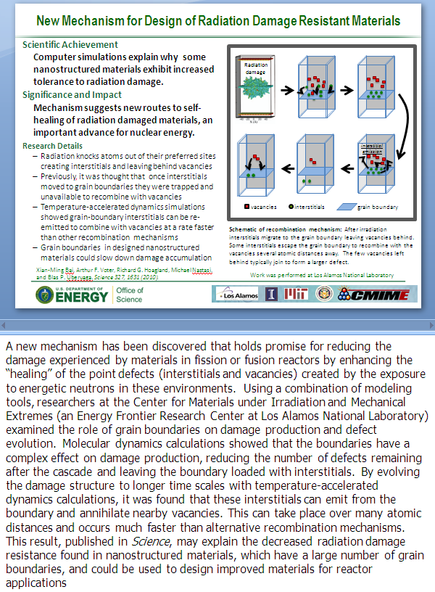
How to Build a DOE Office of Science Highlight Slide
Title
Attention grabbing and accessible but not exaggerated
Text
All text should be short and to the point –
minimize words and stress significance to society
  Scientific Achievement – 50 words or less
  Significance and Impact – 50 words or less
  Importance, relevance, or intriguing component of the finding to the field
  Research Involved – Address the research approach in 2-4 bullet points
  Notes: Give a ~175 word detailed explanation plus additional description of figure if needed in the PowerPoint Notes section
Citation
-If there is a publication, full citation with all authors’ names is preferable
Notes:
Technical Contacts:
Person A (email and institution), Person B (email and institution, etc.)
Supported by:
Sources of funding for this work (e.g., ASCR SciDAC partnership ComPASS and by an ASCR Applied Math project (PI Sven Leyffer))
Notes:
Bullet points or prose to provide additional details and facilitate a program manager to present the slide

Slide 2
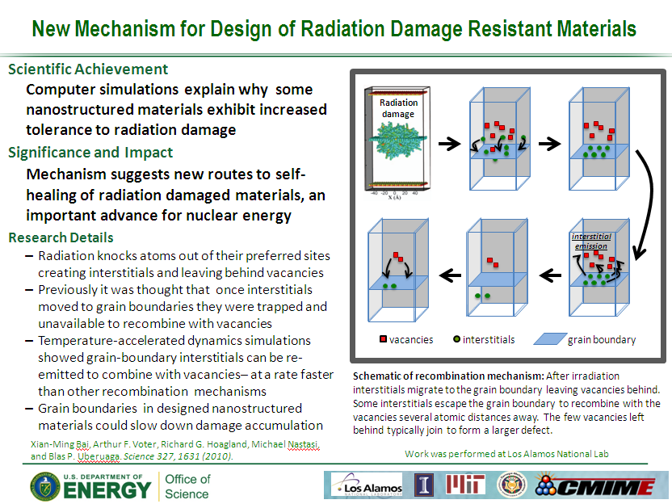
How to Build a DOE Office of Science Highlight Slide
Figures
Visually compelling figure(s) to explain the research
Include legends and descriptive caption
Provide Image Credit
Institutional logo(s)
Include affiliations or institutional logos
Indicate institution where research was
performed (if possible); EFRC and Hub research
should include those logos as well
SC Logos
For Office of Science
Notes:
Technical Contacts:
Person A (email and institution), Person B (email and institution, etc.)
Supported by:
Sources of funding for this work (e.g., ASCR SciDAC partnership ComPASS and by an ASCR Applied Math project (PI Sven Leyffer))
Notes:
Bullet points or prose to provide additional details and facilitate a program manager to present the slide

Slide 3
Format Template – Title (Arial 24 pt, bold)
(try not to use fonts smaller than those in the template)
Figure – can be located as needed on the page….
Scientific Achievement (20 pt Arial, bold)
  One sentence (18 pt Calibri, bold)
Significance and Impact
  One sentence
Research Details
  Detail #1 – can be smaller font than the text above if required, but try to stay at 16 pts or greater. 3 pt line spacing between bullets
  Detail #2
Caption (Calibri 12 pt or greater)
Remember that the shade of green used in these slides is: R-G-B: 16-102-54
Reference (Calibri 12 or 11 pt)
Work was performed at … (Calibri 12 or 11 pt) – can be moved to footer
Notes:
Technical Contacts:
Person A (email and institution), Person B (email and institution, etc.)
Supported by:
Sources of funding for this work (e.g., ASCR SciDAC partnership ComPASS and by an ASCR Applied Math project (PI Sven Leyffer))
Notes:
Bullet points or prose to provide additional details and facilitate a program manager to present the slide

Slide 4
Title
ASCR CS/Math FOA (PI Doe)
Figure – can be located as needed on the page….
Scientific Achievement
  One sentence (18 pt Calibri, bold)
Significance and Impact
  One sentence
Research Details
  Detail #1 – can be smaller font than the text above if required, but try to stay at 16 pts or greater. 3 pt line spacing between bullets
  Detail #2
Caption (Calibri 12 pt or greater)
Update Speaker Notes Below
Reference (Calibri 12 or 11 pt)
ANL: Jane Doe and Ashok Kumar
Notes:
Technical Contacts:
Person A (email and institution), Person B (email and institution, etc.)
Supported by:
Sources of funding for this work (e.g., ASCR SciDAC partnership ComPASS and by an ASCR Applied Math project (PI Jane Doe))
Notes:
Bullet points or prose to provide additional details and facilitate a program manager to present the slide

Slide 5
Title
ASCR CS/Math FOA (PI Doe)
ASCR Base Research, LDRD, Other
Description
Timeline
Further Development (SciDAC)
Description
Outcome & Impact
Big Science including SciDAC Partnerships
ASCR Facilities
Picture
Timeline
Picture
Applied R&D
SBIR
Industry
ECP
Update Speaker Notes Below
ANL: Jane Doe and Ashok Kumar
Notes:
Technical Contacts:
Person A (email and institution), Person B (email and institution, etc.)
Supported by:
Sources of funding for this work (e.g., ASCR SciDAC partnership ComPASS and by an ASCR Applied Math project (PI Jane Doe))
Notes:
Bullet points or prose to provide additional details and facilitate a program manager to present the slide

Slide 6


Descriptive Title Here
Project Title
PI: Name (affiliation)
Team: Doe, Kumar
Scope & Objectives
Cool Image
  Short summary of ECP project (scope, objectives)
  Short summary of challenge problem targets (if applicable)
  What is current FY plan (at a high level)?
  What was the driver for this accomplishment and why?
Visually compelling figure(s) to explain the research
Include legends and descriptive caption
Provide Image Credit
Accomplishments
Impact
  Short summary of ECP project (scope, objectives)
  Short summary of challenge problem targets (if applicable)
  What is current FY plan (at a high level)?
  What was the driver for this accomplishment and why?
  What is the impact of this accomplishment for the community outside of ECP?
  What is the impact of this accomplishment within ECP?
  Who cares about this (stakeholders) and why?
Update Speaker Notes Below
Deliverables | List any milestone report, related publication, and/or data or software release. Include any relevant URLs (github, etc.). Please specify which of these are associated with use of HPC resource(s) and identify system/facility used.
Notes:
Technical Contacts:
Person A (email and institution), Person B (email and institution, etc.)
Supported by:
Sources of funding for this work (e.g., ASCR SciDAC partnership ComPASS and by an ASCR Applied Math project (PI Jane Doe))
Notes:
Bullet points or prose to provide additional details and facilitate a program manager to present the slide
6

