Slide 1

Getting ready to postdoc: role of postdocs, supervisors and mentors in postdoc development and quick guide for ANL-698, ANL-699 and mentoring forms
Kristene “tina” Henne, Phd
Postdoctoral Program Lead
Argonne Leadership Institute

Slide 2
Definition of “postdoc”
Endorsed by the National Postdoctoral Association
A postdoctoral scholar ("postdoc") is an individual holding a doctoral degree who is engaged in a temporary period of mentored research and/or scholarly training for the purpose of acquiring the professional skills needed to pursue a career path of his or her choosing.

Slide 3
Sample Postdoctoral timeline
Permanent career!
Postdoctoral Appointments are temporary by design
Year 1
Set goals, start research, get connected
Year 2
Continued progress integrated into lab community, learning towards independence
Year 3
Meeting milestones, finishing projects and deliverables, planning for career transition, job search
ANL-699
Career Plan
ANL-699
Review Goals
ANL-698 Mentoring Plan

Slide 4
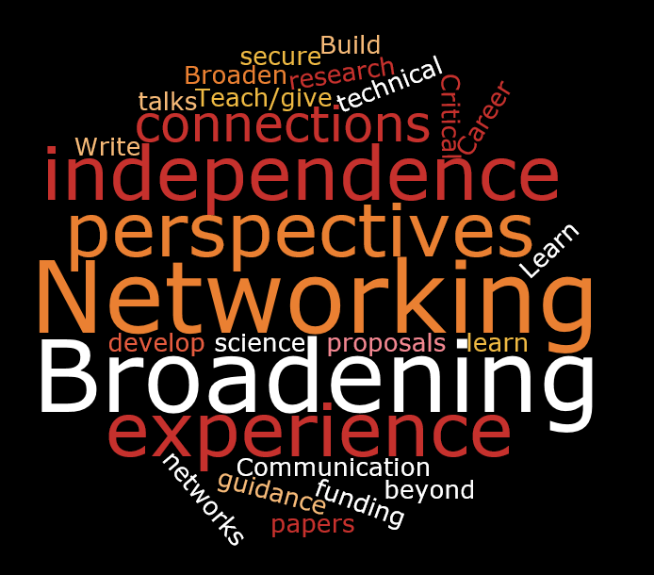
What is the purpose of a postdoc? What do they need?
Major Themes Emerged Over the Years
Postdocs are here to:
Learn new things
Expand network
Broaden experience and skills
Learn to become independent
Get to next step of career
What do they need?
Broad perspectives
Connections/Networking
Guidance—career and technical
Independence
What skills do they need?
How to secure funding
Communication skills
Critical thinking
Teamwork
Develop connections and proposals
Skills “beyond science”

Slide 5
Postdoc development needs
Career exploration, building professional skills, planning for next steps to get to the next stage of their career
Career Exploration
Professional Skills
Career Transition Planning
Permanent Career

Slide 6
The postdoc experience
The Postdoc, Supervisor and Mentor each play a role in postdoc development.
Postdoc
Supervisor (and Other Leaders)
The Postdoc Experience
Mentor

Slide 7
What can supervisors do to support postdocs?
Supervisors can impact a postdoc’s experience and career
Impact of Supervisors
Open opportunities for postdoc to “own” their work
Established networks
Encourage learning by doing
Impact on career paths
Provide letters of recommendation
Supervisor Expectations
Onboard postdoc and help acclimate to work environment
Meet regularly with postdocs to discuss research and provide feedback
Provide opportunities for authorship, presentations, proposal writing and other means of establishing independence
Give postdocs a chance to explore ideas
Supervisor as Mentor?
Consider impact on postdoc’s career
Make connections within and beyond your division to foster collaboration and expand networks
Foster independence
Foster Independence
Guide
Listen
Notes:
Discussion:
1. Ask audience, “what does it mean for postdocs to “own” work?
Possible answers:
Take lead on publications—organize content for the paper, communicate with collaborators, prepare for submission
Act as corresponding author and lead response to reviews
Take the lead on proposing how to approach main research question, even if in a defined project
Others?
2. Ask audience, “how often do you meet with your postdocs? What is a good frequency?
3. What are some ways you can give postdocs a chance to explore ideas?
Possible answers:
Write LDRD proposals
Look for funding opportunities related to work and interests and discuss ideas for response
Encourage attendance at seminars across the lab that might lead to ideas for collaboration
Others?

Slide 8

The Role of the Mentor in postdoc development
Mentors can help broaden perspectives
Seek a mentor who:
Is outside line management or group
Has a different experience or perspective
Can be an independent source of guidance and advice
Complements your supervisor’s experience
Value add of mentors:
Expand networks, especially outside the group or division
Serve as a “sounding board” for postdoc issues and advocate for postdocs
Expand mentee’s outlook and perspectives
Help postdocs understand culture, expectations and rights
Role of mentor versus supervisor?
Mentoring focuses on the professional and personal growth of the mentee
Supervision also focuses on the postdoc’s performance, work environment and meeting research objectives
Notes:
Why is it a good idea to have a mentor outside line management or group?
Possible answers:
Offers safe, confidential path for discussing topics of interest to the postdoc
Minimizes conflict of interest
Expands networks—benefit could be paths to collaboration, generation of ideas, expanded network for job search

Slide 9

What can leadership do to support postdocs?
Role of Division/Group/Department Leaders:
Support supervisors
Provide guidance to all staff
Help manage relationships within the group
How can a Leaders enhance the postdoc experience?
Reinforce expectations for staff
Help manage relationships with PI’s
Help manage issues within the group
Be mindful of postdoc accomplishments
What do we need to be successful?
Clarity around roles and expectations, regardless of funding source
Leverage and support within the group and from the division
Clear path for issues management—who to go to, when and for what?

Slide 10
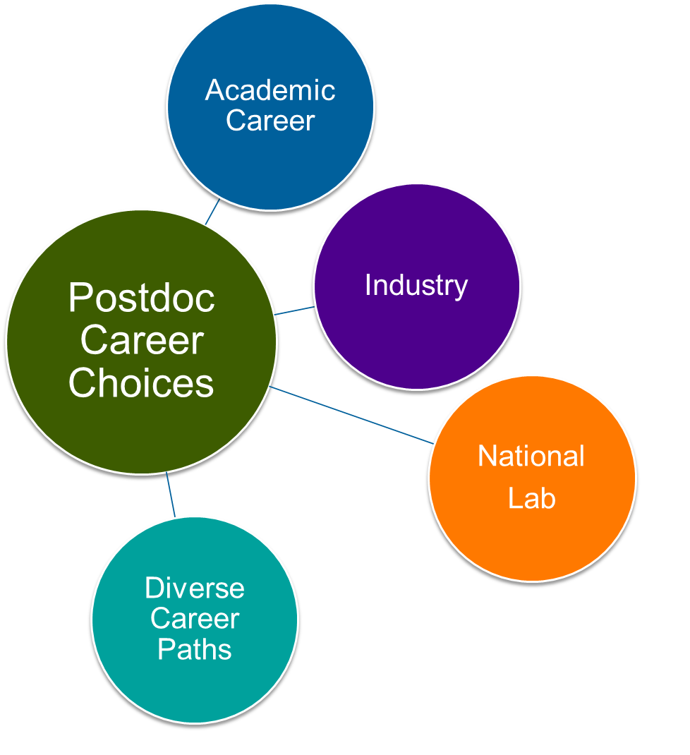
What is the role of the postdoc?
Postdocs are the “owners” of their careers
Role of a Postdoc:
Carry out research in support of Argonne and DOE missions
Meet deliverables as discussed with Supervisor and Principal Investigators
Build skills to enhance career transitions
How can Postdoctoral Appointees enhance their own experience?
Discuss career objectives with supervisors, mentors and group leaders
Maintain open communication with line management regarding research progress, challenges, and barriers to success
Be proactive in own professional development and career growth
What do they need to be successful?
Clear roles and expectations
Open lines of communication
Opportunities to develop skills—both research and “soft” skills
“Postdoctoral appointments offer appointees the opportunity to extend technological skills, test
research capabilities, and develop the individual's potential for independent research.”
--from LMS-POL-38

Slide 11
What about all those forms?

Slide 12
Important documents for postdoc appointments
Document | Purpose | When to Complete
Initial Discussion Form, ANL-698 | Establish research and career goals with supervisor Set expectations for performance Identify key skills and development opportunities Set a baseline for research objectives Orient postdoc on Argonne culture and core values | 1-3 Weeks following start date
Mentoring Agreement Form | Identify mentor of record Establish mentoring relationship | Within first 90 days
Annual Development Discussion Form, ANL-699 | Reflect on accomplishments and progress towards goals Identify strengths as an early career researcher Establish goals—development and research—for the next year Reflect on mentoring goals Identify opportunities for professional development Obtain feedback from supervisor, mentor and division leadership | Beginning 90 days from anniversary date, you should meet with your supervisor to discuss your accomplishments and goals and then complete the form. This should be completed no less than 3 weeks prior to your anniversary date to avoid delays in extending your appointment.

Slide 13
Initial development discussion (anl-698)
The ANL-698 focuses on 4 main questions.
Career Goals
What do you want to do after your postdoc appointment?
How will the postdoc appointment get you there?
Research Goals
What are the expected outcomes and output for your research project?
What do you need to accomplish research goals?
Professional Development
What skills are needed to meet your career and research goals?
What opportunities are there to learn and build a reputation in your research community?
Mentoring
How can your mentor help you with these goals and your development?
Can you identify specific things to work on?
What do you need from your mentor?

Slide 14
What else should postdocs be learning?
Postdoctoral Core Competency | Examples
Discipline-specific conceptual knowledge | Analytical approach to defining scientific questions Broad based and cross-disciplinary knowledge Detailed knowledge of specific research area
Research skill development | Research techniques and laboratory safety Experimental design, Data analysis and interpretation Effective search strategies and critical evaluation of the literature Grant application and scientific publishing processes
Communication skills | Writing, Speaking, Presenting Interpersonal and Networking Mentoring/Teaching
Professionalism | Inclusive behavior, promoting diversity Professional and workplace ethics and etiquette Collaboration, professional service Self-awareness, stress management, work/life integration
Leadership and management skills | Project management Running meetings, delegating responsibilities Teamwork, motivating & connecting with others
Responsible conduct of research | Identifying & mitigating research misconduct Data sharing, publishing Managing conflicts of interest
National Postdoctoral Association Core Competencies: http://www.nationalpostdoc.org/?CoreCompetencies
Notes:
There is a model of learning and professional development called the 70-20-10 model, which suggests that:
the bulk of learning should come from on-the-job experiences (70)
the next source of learning should be from feedback, coaching and mentoring (20)
the last source is formal educational opportunities (workshops, courses, seminars, online learning, reading) (10)
How can we shape the postdoc experience to address the core competencies, keeping the 70-20-10 model in mind?
References:
70-20-10 Model: https://www.bridgespan.org/insights/library/leadership-development/the-70-20-10-leadership-development-model
Coaching the Individual Development Plan Discussion. Resource developed by Laura Altergott, Senior Leadership Development Manager, Argonne National Laboratory

Slide 15
Annual development discussion (ANL-699)
The ANL-699 is a chance to reflect on your accomplishments, strengths and development
Mentoring Plan Accountability
How are you approaching your mentoring?
Are you meeting with your mentor?
Progress on Goals and Research Experience
How are you progressing with your research goals?
Performance Focus
What do you excel at?
Development Focus
What are some areas you would like to focus on for your development?
What are your major accomplishments and learning achievements?
What are some examples from your experiences that illustrate your strengths?
Are their new skills or goals to work towards?
How can your mentor help?

Slide 16
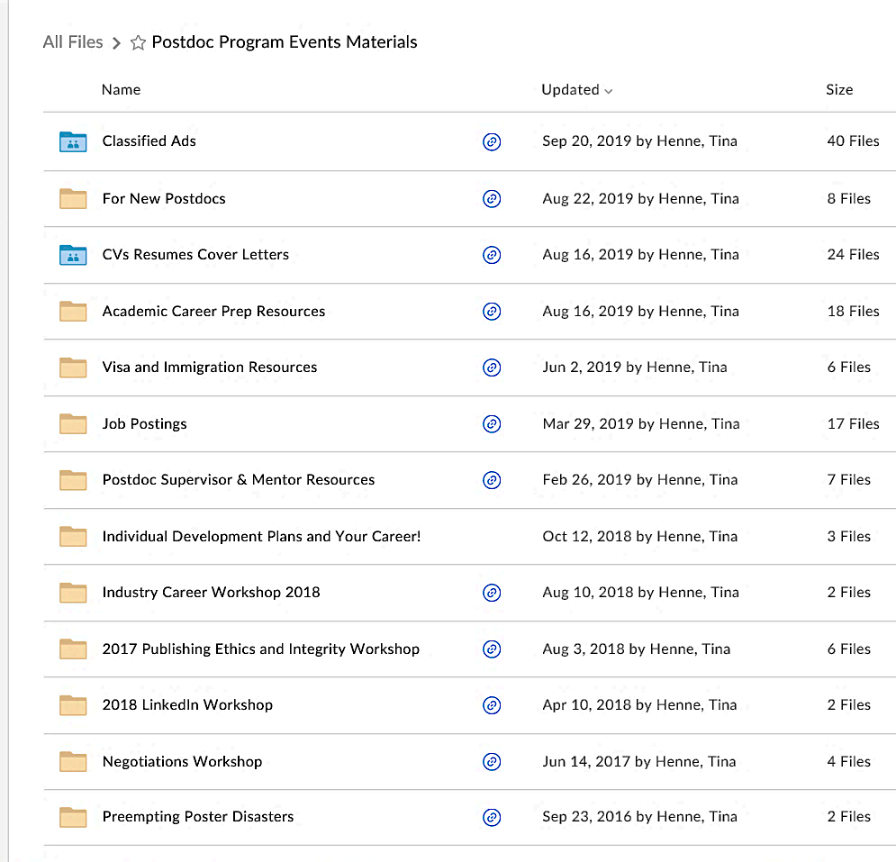
Where can I find postdoc resources?
Postdoc Program Events Materials Box Folder
All materials from career workshops
Mentoring program guidance and resources
Development Plan Templates
Classified Ads
Visa and Immigration Resources
To set up a Box Account go to https://inside.anl.gov/services/box
Resources for your mentor and supervisor
Link in every weekly PSA Newsletter

Slide 17
Accessing resources and connecting to the postdoc community
Postdoc-events email list:
  For visiting postdocs and others who are working at Argonne and want to be included in Postdoc Office and Postdoc Society events
  Subscribe at https://lists.anl.gov/mailman/listinfo/postdoc-events (Argonne DASH or VPN required)
  NOTE: Argonne postdocs and Argonne Scholars are automatically added to the HR-generated email list, postdoc@anl.gov
Postdoctoral Society of Argonne:
  Check out the PSA MyArgonne page for information on PSA mission, initiatives and activities
  Connect with postdocs on the PSA Slack Channel
Postdoc Program Resources Box Folder:
  Access resources for career & professional development, mentoring, acclimating to the area and working in the US
  Materials for postdocs, mentors and supervisors available
  Box Link: https://anl.box.com/v/PostdocProgramMaterials

Slide 18
CELS Postdoctoral mentoring program coordinators
Divisional Postdoctoral Mentoring Program Coordinators:
  Assist new postdocs with finding mentors
  Promote mentoring within divisions
  Serve as a liaison with the postdoc office
Current CELS Coordinators:
  CPS: Paul Romano
  DSL: Justin Wozniak
  EVS: Cristina Negri
  LCF: Vitali Morozov
  MCS: Tom Peterka

